Slide 1
Statistics
Measures of Central Tendency and Dispersion

Slide 2
Levels of Data Measurement
Nominal — Lowest level of measurement
Ordinal
Interval
Ratio — Highest level of measurement
Notes:
21
18

Slide 3
Nominal Level Data
Numbers are used to classify or categorize
Example: Employment Classification
1 for Educator
2 for Construction Worker
3 for Manufacturing Worker
Example: Ethnicity
1 for African-American
2 for Anglo-American
3 for Hispanic-American
Notes:
22
19

Slide 4
Ordinal Level Data
Numbers are used to indicate rank or order
Relative magnitude of numbers is meaningful
Differences between numbers are not comparable
Example: Ranking productivity of employees
Example: Taste test ranking of three brands of soft drink
Example: Position within an organization
1 for President
2 for Vice President
3 for Plant Manager
4 for Department Supervisor
5 for Employee
Notes:
23
20

Slide 5
Example of Ordinal Measurement
Notes:
24
21

Slide 6
Ordinal Data
Faculty and staff should receive preferential treatment for parking space.
Strongly
Agree
Neutral
Disagree
Strongly
Agree
Disagree
1
2
3
4
5

Slide 7
Interval Level Data
Distances between consecutive integers are equal
Relative magnitude of numbers is meaningful
Differences between numbers are comparable
Location of origin, zero, is arbitrary
Vertical intercept of unit of measure transform function is not zero
Example: Fahrenheit Temperature
Example: Calendar Time
Example: Monetary Utility
Notes:
26
22

Slide 8
Ratio Level Data
Highest level of measurement
Relative magnitude of numbers is meaningful
Differences between numbers are comparable
Location of origin, zero, is absolute (natural)
Vertical intercept of unit of measure transform function is zero
Examples: Height, Weight, and Volume
Example: Monetary Variables, such as Profit and Loss, Revenues, and Expenses
Example: Financial ratios, such as P/E Ratio, Inventory Turnover, and Quick Ratio.
Notes:
27
23

Slide 9
Usage Potential of Various Levels of Data
Ratio
Interval
Ordinal
Nominal
Notes:
28
24

Slide 10
Data Level, Operations and Statistical Methods
Data Level
Meaningful Operations
Statistical
Methods
Nominal
Ordinal
Interval
Ratio
Classifying and Counting
All of the above plus Ranking
All of the above plus Addition, Subtraction, Multiplication, and Division
All of the above
Nonparametric
Nonparametric
Parametric
Parametric
Notes:
29
25

Slide 11
Descriptive Statistics: Numerical Measures
Measures of Central Tendency/ Measures of Central Location
Mean
Median
Mode
Percentile
Quartile

Slide 12
Descriptive Statistics: Numerical Measures
Measures of Dispersion/ Variability
Range
Interquartile Range
Variance
Standard Deviation
Coefficient of Variance

Slide 13
Central Tendency/Location
Central tendency is the middle point of a distribution.
Measures of central tendency are also called measures of location.
Dispersion/ Variability
Dispersion is spread of the data in a distribution, that is, the extent
to which the observations are scattered.
Dispersion is contrasted with location or central tendency.

Slide 14
Mean
For a data set, mean is sum of the values divided by the number of values.
Mean is a unique measure of central tendency, because every data set has one and only one mean.
It is highly influenced by extreme values.
Mean can not be calculated for open class interval.
Mean can be calculated only for quantitative measurement.
Applicable for interval and ratio data
Not applicable for nominal or ordinal data
Affected by each value in the data set, including extreme values

Slide 15
Sample Mean
Sum of the values
of the n observations
Number of
observations
in the sample

Slide 16
Example :
If the score of students in a class are 1,2,3,4,20 So if we calculate the mean =(1+2+3+4+20)/5=30/5=6 Median =3 So, median is better or appropriate measure because 20 is much greater than other numbers and because of 20 the mean has come out to 6. ∴ Its better to take median than mean.

Slide 17
Weighted Mean
The weighted mean enables us to calculate an average, that takes into account the importance of each value to the overall total.
Weighted mean is calculated when there are several observation having same value but different frequencies.

Slide 18
Geometric Mean
When we are dealing with quantities that change over a period of time, we are interested to know an average rate of change.
In such cases, geometric mean is preferred over arithmetic mean.
Geometric mean is used to show multiplicative effects over time in compound interest and inflation calculations.

Slide 19
Median
The median is a single value from the data set that measures the central item in the data.
Median is not influenced by extreme values.
Easy to understand and can be calculated for any kind of data, even for grouped data with open-ended classes.
Middle value in an ordered array of numbers.
Applicable for ordinal, interval, and ratio data
Not applicable for nominal data
Unaffected by extremely large and extremely small values.

Slide 20
For an odd number of observations:
26
18
27
12
14
27
19
7 observations
12
14
18
19
26
27
27
in ascending order
the median is the middle value.
Median = 19

Slide 21
For an even number of observations:
26
18
27
12
14
27
30
19
8 observations
12
14
18
19
26
27
27
30
in ascending order
the median is the average of the middle two values.
Median = (19 + 26)/2 = 22.5

Slide 22
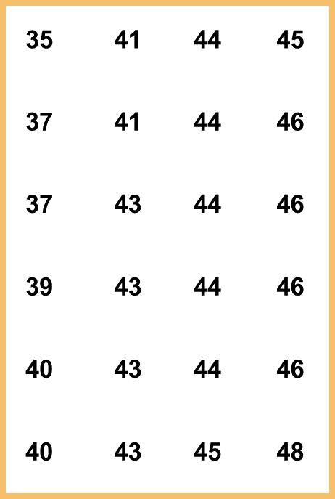
Mode
The most frequently occurring value in a data set.
Applicable to all levels of data measurement (nominal, ordinal, interval, and ratio)
Bimodal -- Data sets that have two modes
Multimodal -- Data sets that contain more than two modes
Example: The mode is 44.
There are more 44s than any other value.

Slide 23
Mode
Mode is different from mean but somewhat similar to median, because it is not actually calculated by process of arithmetic.
Mode can be used as a measure of location for quantitative as well as qualitative data.
Mode is not affected by extreme values and can be used for open-ended data also.
If data set has two or more modes, it is difficult to intercept.
For continuous data, sometimes there is no mode.

Slide 24
Mode
Example: Apartment Rents
450 occurred most frequently (7 times)
Mode = 450
Note: Data is in ascending order.

Slide 25
Difference
Sr.No | Mean | Median | Mode
1 | The average taken of given observations is called Mean. | The middle number in a given set of observations is called Median. | The most frequently occurred number in a given set of observations is called mode.
2 | Add up all the numbers and divide by the total number of terms | Place all the numbers in ascending or descending order | the mode is derived when a number has frequency occurred in a series
3 | Once the above step is finished, what we get is the mean. | After arranging everything from smallest to biggest, take out the middle number, which is your median. | The mode can be one or more than one. It is possible to have no mode at all, as well
4 | Mean is the arithmetic mean or in a simple way can be a simple average or weighted average. | When series have even numbers, median is the simple average of the middle pair of numbers. | If there is a unique data set, there is no mode at all.
5 | When data is normally distributed, the mean is widely preferred. | When data distribution is skewed, median is the best representative. | When there is a nominal distribution of data, the mode is preferred.

Slide 26
Variability
No Variability in Cash Flow
Mean
Mean
Variability in Cash Flow
Mean
Mean
Notes:
20

Slide 27
Variability
Variability
No Variability
Notes:
21

Slide 28
Range
The range is the difference between the highest and lowest observed values.
The range is easy to understand and to find, but its usefulness as a measure of dispersion is limited.
In open-ended distributions, range can not be calculated.
Range depends only on two observations of the dataset.
Ignores all data points except the two extremes

Slide 29
Interquartile Range
Range of values between the first and third quartiles
Range of the “middle half”
Less influenced by extremes
The interquartile range of a data set is the difference between the third quartile and the first quartile.
It is the range for the middle 50% of the data.
It overcomes the sensitivity to extreme data values.

Slide 30
Variance
The variance of a random variable or distribution is the expectation or mean of the squared deviation of that variable from its expected value or mean.
Thus, the variance is a measure of the amount of variation of the values of that variable, taking account of all possible values and their probabilities.
The variance is the average of the squared differences between each data value and the mean.
for a
sample
for a
population

Slide 31
Standard Deviation
Standard deviation is square root of the variance.
It is widely used measure of dispersion.
It is used to compare distributions and to compute standard scores.
It cannot be computed from open-ended classes.
Extreme values in distribution affect the value of standard deviation.
It is measured in the same units as the data, making it more easily interpreted than the variance.

Slide 32
Coefficient of Variation
Standard deviation is an absolute measure of dispersion that expresses variation in the same units as in the original data.
The standard deviation can not be sole basis for comparing two distributions.
The coefficient of variation relates standard deviation and the mean by expressing standard deviation as percentage of mean.

Slide 33
Distribution Shape: Skewness
An important measure of the shape of a distribution is called skewness.
The formula for the skewness of sample data is
Skewness can be easily computed using statistical software.

Slide 34
Distribution Shape: Skewness
Symmetric (not skewed)
Skewness is zero.
Mean and median are equal.
Skewness = 0
.35
.30
.25
.20
Relative Frequency
.15
.10
.05
0

Slide 35
Distribution Shape: Skewness
Moderately Skewed Left
Skewness is negative.
Mean will usually be less than the median.
Skewness = − .31
.35
.30
.25
.20
Relative Frequency
.15
.10
.05
0

Slide 36
Distribution Shape: Skewness
Moderately Skewed Right
Skewness is positive.
Mean will usually be more than the median.
Skewness = .31
.35
.30
.25
.20
Relative Frequency
.15
.10
.05
0

Slide 37
Distribution Shape: Skewness
Highly Skewed Right
Skewness is positive (often above 1.0).
Mean will usually be more than the median.
Skewness = 1.25
.35
.30
.25
.20
Relative Frequency
.15
.10
.05
0

Slide 38
Distribution Shape: Skewness
Example: Apartment Rents
Seventy efficiency apartments were randomly sampled in a college town. The monthly rent prices for the apartments are listed below in ascending order.

Slide 39
Distribution Shape: Skewness
Example: Apartment Rents
Skewness = .92
.35
.30
.25
.20
Relative Frequency
.15
.10
.05
0

Slide 40
z-Scores
The z-score is often called the standardized value.
It denotes the number of standard deviations a data value $x_{i}$is from the mean.
Excel’s STANDARDIZE function can be used to compute the z-score.

Slide 41
z-Scores
An observation’s z-score is a measure of the relative location of the observation in a data set.
A data value less than the sample mean will have a z-score less than zero.
A data value greater than the sample mean will have a z-score greater than zero.
A data value equal to the sample mean will have a z-score of zero.

Slide 42
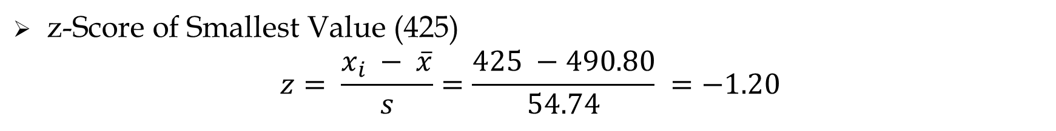
z-Scores
Example: Apartment Rents
z-Score of Smallest Value (425)
$$z= \frac{x_{i} − \overline{x}}{s}=\frac{425 −490.80}{54.74} =−1.20$$

Slide 43
z-Scores
Standardized Values for Apartment Rents

Slide 44
Examples:
Consider a sample with data values of 10, 20, 12, 17, and 16. Compute the z-score for each of the five observations.
Consider a sample with a mean of 500 and a standard deviation of 100. What are the z-scores for the following data values: 520, 650, 500, 450, and 280?

Slide 45
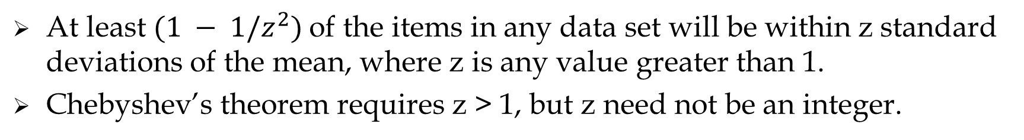
Chebyshev’s Theorem
At least $(1 − 1/z^{2})$of the items in any data set will be within z standard deviations of the mean, where z is any value greater than 1.
Chebyshev’s theorem requires z > 1, but z need not be an integer.
At least of the data values must be
within of the mean.
75%
z = 2 standard deviations
At least of the data values must be
within of the mean.
89%
z = 3 standard deviations
At least of the data values must be
within of the mean.
94%
z = 4 standard deviations

Slide 46
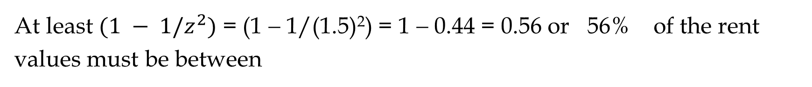

Examples: Apartment Rents
Let z = 1.5 with $\overline{x}$ = 490.80 and s = 54.74
At least $(1 − 1/z^{2})$ = (1 − 1/(1.5)²) = 1 − 0.44 = 0.56 or 56% of the rent
values must be between
$$\overline{x} −z\left(s\right)=490.80 −1.5\left(54.74\right)= 409$$
and
$$\overline{x}+z\left(s\right)=490.80+1.5\left(54.74\right)= 573$$
(Actually, 56% of the rent values are between 409 and 573.)

Slide 47
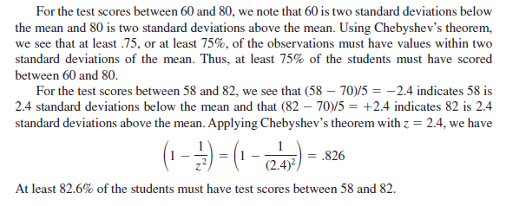
Examples:
Suppose that the midterm test scores for 100 students in a college business
statistics course had a mean of 70 and a standard deviation of 5.
How many students had test scores between 60 and 80?
How many students had test scores between 58 and 82?

Slide 48
Example:
Consider a sample with a mean of 30 and a standard deviation of 5. Use
Chebyshev’s theorem to determine the percentage of the data within each
of the following ranges:
20 to 40
15 to 45
22 to 38
18 to 42
12 to 48

Slide 49
Empirical Rule
When the data are believed to approximate a bell-shaped distribution …
The empirical rule can be used to determine the percentage of data values
that must be within a specified number of standard deviations of the mean.
The empirical rule is based on the normal distribution, which is covered
in Chapter 6.

Slide 50
Empirical Rule
For data having a bell-shaped distribution:
of the values of a normal random variable are within
of its mean.
68.26%
+/- 1 standard deviations
of the values of a normal random variable are within
of its mean.
95.44%
+/- 2 standard deviations
of the values of a normal random variable are within
of its mean.
99.72%
+/- 3 standard deviations

Slide 51
Empirical Rule
99.72%
95.44%
68.26%
x
μ
μ – 3σ
μ – 1σ
μ + 1σ
μ + 3σ
μ – 2σ
μ + 2σ

Slide 52
Example:
Suppose the data have a bell-shaped distribution with a mean of 30 and
a standard deviation of 5. Use the empirical rule to determine the
percentage of data within each of the following ranges:
20 to 40
15 to 45
25 to 35

Slide 53
Detecting Outliers
An outlier is an unusually small or unusually large values in a data set.
A data value with a z-score less than -3 or greater than +3 might be considered an Outlier.
It might be:
an incorrectly recorded data value
a data value that was incorrectly included in the data set
a correctly recorded data value that belongs in the data set

Slide 54
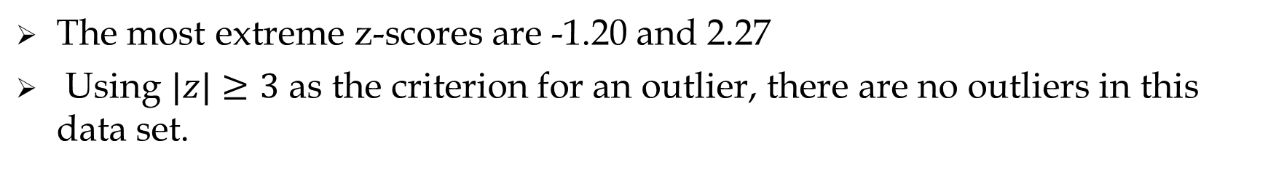
Detecting Outliers
Example: Apartment Rents
The most extreme z-scores are -1.20 and 2.27
Using $|z|≥3$ as the criterion for an outlier, there are no outliers in this data set.
Standardized Values for Apartment Rents

Slide 55
Exploratory Data Analysis
Exploratory data analysis procedures enable us to use simple
arithmetic and easy-to-draw pictures to summarize data.
We simply sort the data values into ascending order and identify the
Five-Number Summary and then construct a Box-Plot.

Slide 56
Five-Number Summary
1
Smallest Value
2
First Quartile
3
Median
4
Third Quartile
5
Largest Value

Slide 57
Five-Number Summary
Example: Apartment Rents
Lowest Value = 425
First Quartile = 445
Median = 475
Third Quartile = 525
Largest Value = 615

Slide 58
Box Plot
A Box Plot is a graphical summary of data that is based on a
five-number summary.
A key to the development of a box plot is the computation of the
median and the quartiles Q1 and Q3.
Box plots provide another way to identify outliers.

Slide 59
Box-Plot
Example: Apartment Rents
A box is drawn with its ends located at the first and third quartiles.
A vertical line is drawn in the box at the location of the median (second quartile).
400
425
450
475
500
525
550
575
600
625
Q1 = 445
Q3 = 525
Q2 = 475

Slide 60
Box-Plot
Limits are located (not drawn) using the interquartile range (IQR).
Data outside these limits are considered outliers.
The locations of each outlier is shown with the symbol * .
The lower limit is located 1.5(IQR) below Q1.
Lower Limit: Q1 - 1.5(IQR) = 445 - 1.5(80) = 325
The upper limit is located 1.5(IQR) above Q3.
Upper Limit: Q3 + 1.5(IQR) = 525 + 1.5(80) = 645
There are no outliers (values less than 325 or greater than 645) in the apartment rent data.

Slide 61
Box-Plot
Example: Apartment Rents
Whiskers (dashed lines) are drawn from the ends of the box to the smallest and largest data values inside the limits.
400
425
450
475
500
525
550
575
600
625
Smallest value
inside limits = 425
Largest value
inside limits = 615

Slide 62
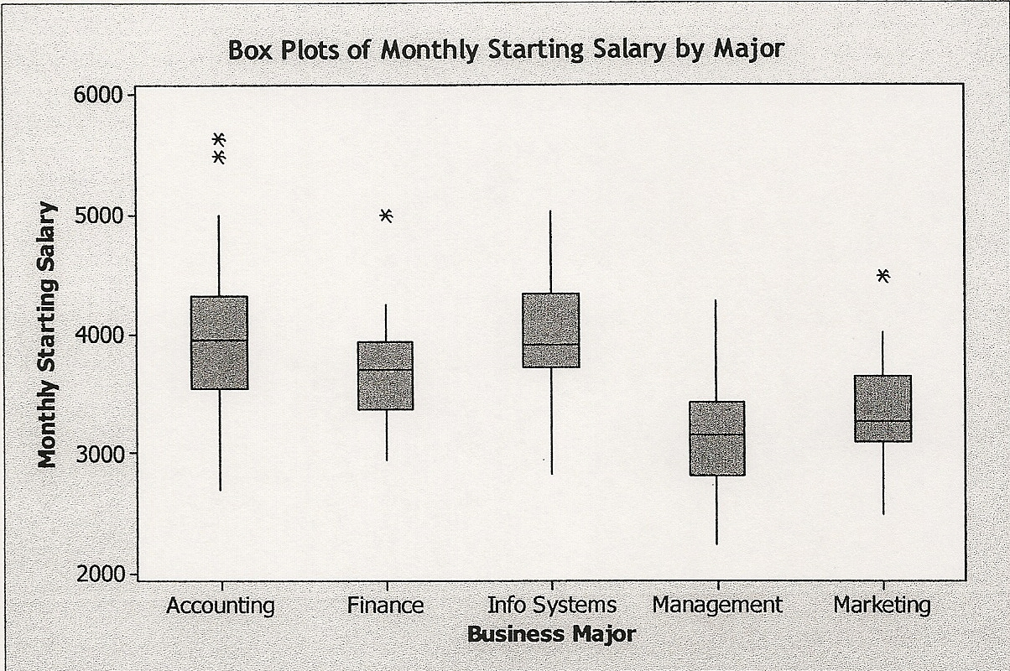
Box-Plot
An excellent graphical technique for making comparisons among two or more groups.

Slide 63
Example:
Consider a sample with data values of 27, 25, 20, 15, 30, 34, 28, and 25.
Provide the five number summary for the data. Show the box plot for
the Data.
Show the five-number summary and the box plot for the following data:
5, 15, 18, 10, 8,12, 16, 10, 6.
A data set has a first quartile of 42 and a third quartile of 50. Compute the
lower and upper limits for the corresponding box plot. Should a data
value of 65 be considered an outlier?

Slide 64
Statistics
Correlation Analysis

Slide 65
Measure of Association between Two Variables
We have examined numerical methods used to summarize
the data for one variable at a time.
Often a manager or decision maker is interested in the relationship
between two variables.
Two descriptive measures of the relationship between two variables
are covariance and correlation coefficient.

Slide 66
Covariance
The covariance is computed as follows:
for samples
for populations

Slide 67
Covariance
The covariance is a measure of the linear association between
two variables.
Positive values indicate a positive relationship.
Negative values indicate a negative relationship.

Slide 68
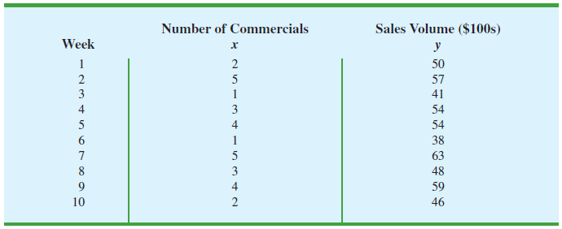
Example
The store’s manager wants to determine the relationship between the number
of weekend television commercials shown and the sales at the store during
the following week. Sample data with sales expressed in Hundreds of dollars
are provided in Table. It shows 10 observations (n = 10), one for each week.
Sample data for the stereo and sound equipment store

Slide 69
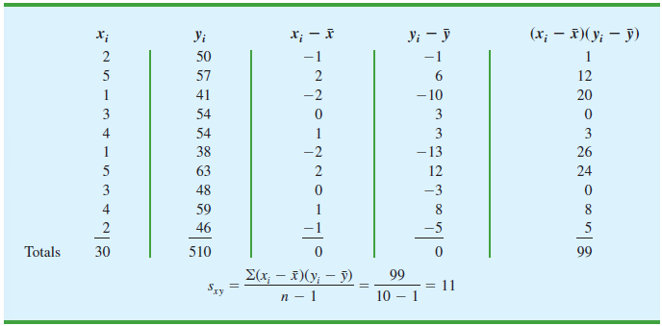
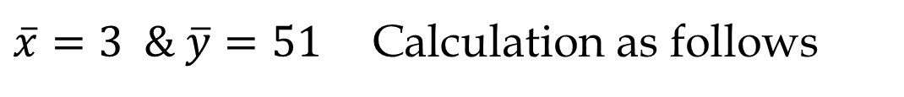
Example
$\overline{x}=3 \& \overline{y}=51$Calculation as follows

Slide 70
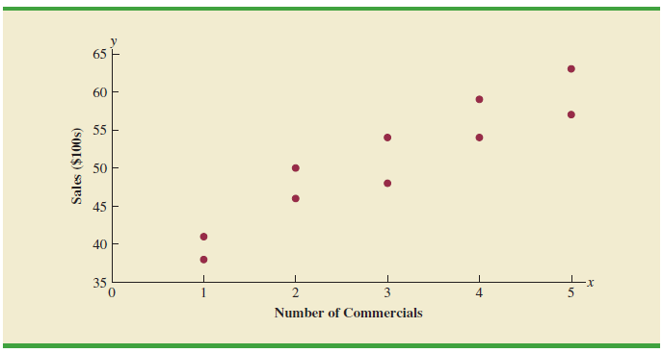
Example
The scatter diagram in Figure shows a positive relationship, with higher
sales (y) associated with a greater number of commercials (x). In fact, the
scatter diagram suggests that a straight line could be used as an
approximation of the relationship.
Scatter diagram for the stereo and sound equipment store

Slide 71
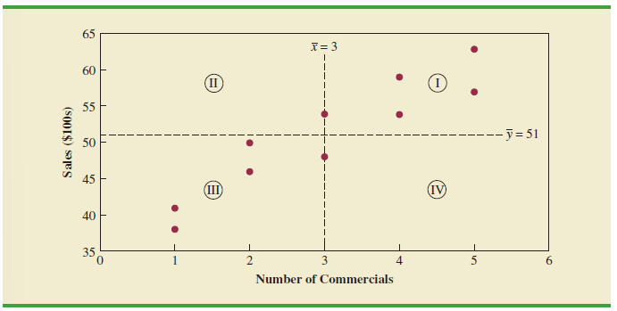
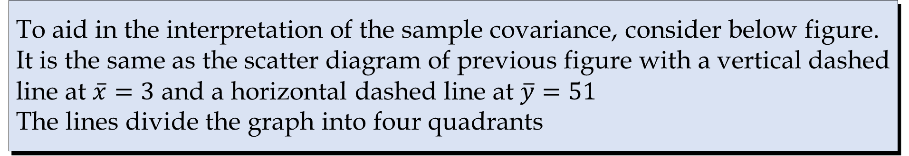
Interpretation of the Covariance
To aid in the interpretation of the sample covariance, consider below figure.
It is the same as the scatter diagram of previous figure with a vertical dashed
line at $\overline{x}=3$ and a horizontal dashed line at $\overline{y}=51$
The lines divide the graph into four quadrants
Partitioned scatter diagram for the stereo and sound Equipment store

Slide 72
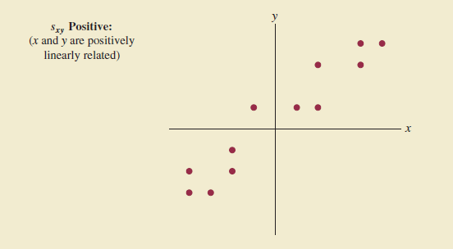
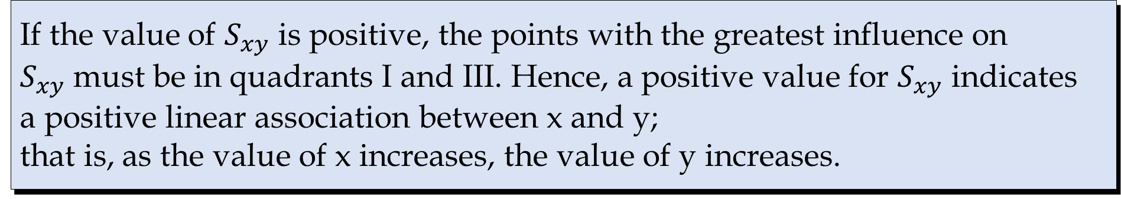
Positive: Interpretation of the Covariance
If the value of $S_{xy}$ is positive, the points with the greatest influence on
$S_{xy}$must be in quadrants I and III. Hence, a positive value for $S_{xy}$ indicates
a positive linear association between x and y;
that is, as the value of x increases, the value of y increases.

Slide 73
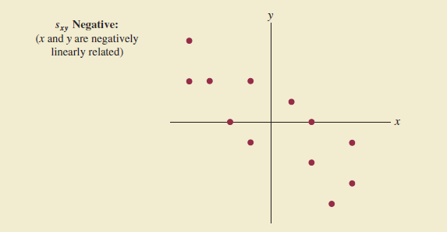
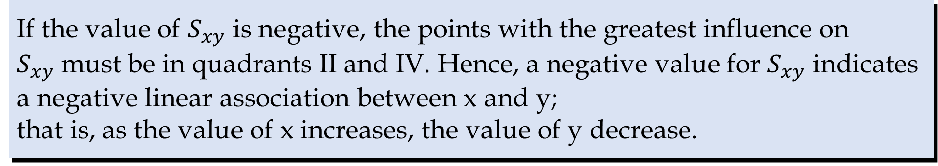
Negative: Interpretation of the Covariance
If the value of $S_{xy}$ is negative, the points with the greatest influence on
$S_{xy}$must be in quadrants II and IV. Hence, a negative value for $S_{xy}$ indicates
a negative linear association between x and y;
that is, as the value of x increases, the value of y decrease.

Slide 74
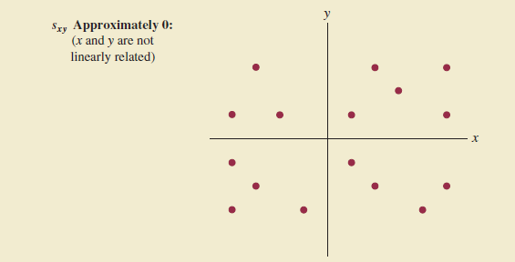
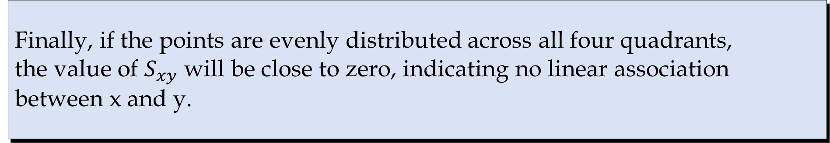
Zero: Interpretation of the Covariance
Finally, if the points are evenly distributed across all four quadrants,
the value of $S_{xy}$ will be close to zero, indicating no linear association
between x and y.

Slide 75
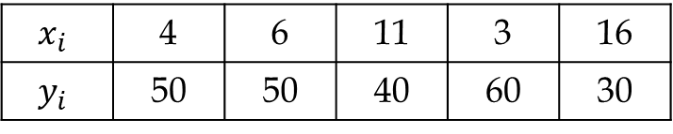
Example
Five observations taken for two variables follow.
$$x_{i}$$ | 4 | 6 | 11 | 3 | 16
$$y_{i}$$ | 50 | 50 | 40 | 60 | 30
Develop a scatter diagram with x on the horizontal axis.
What does the scatter diagram developed in part (a) indicate about the relationship between the two variables?
Compute and interpret the sample covariance.

Slide 76
Correlation Coefficient
Correlation is a measure of linear association and not
necessarily causation.
Just because two variables are highly correlated, it does not mean that
one variable is the cause of the other.

Slide 77

Correlation Coefficient (Karl-Pearson’s Coefficient)
The correlation coefficient is computed as follows:
$r_{xy}=$sample correlation coefficient
$S_{xy}=$sample covariance
$S_{x}$=sample standard deviation of x
$S_{y}$=sample standard deviation of y
$ρ_{xy}$=population correlation coefficient
$σ_{xy}\text{=}\text{population}$covariance
$σ_{x}$ =population standard deviation of x
$σ_{y}$=population standard deviation of y
for samples
for populations

Slide 78
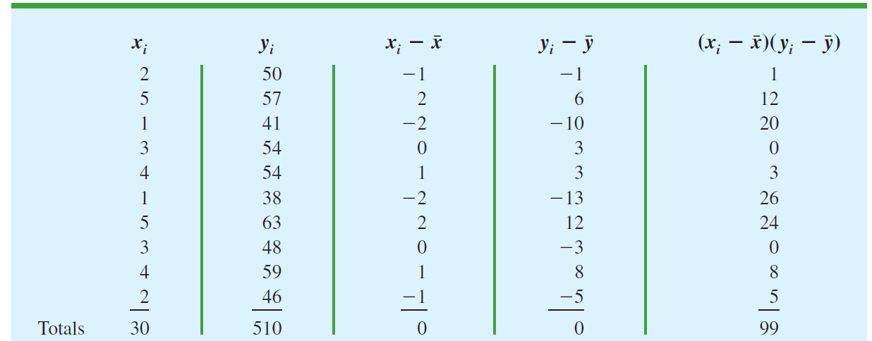
Example
The store’s manager wants to determine the relationship between the number of weekend television
commercials shown and the sales at the store during the following week. Sample data with sales
expressed in Hundreds of dollars are provided in Table. It shows 10 observations (n = 10),
one for each week.
$\overline{x}=3 \& \overline{y}=51$Calculation as follows

Slide 79
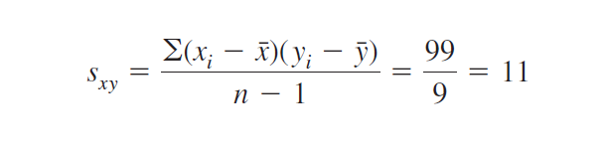
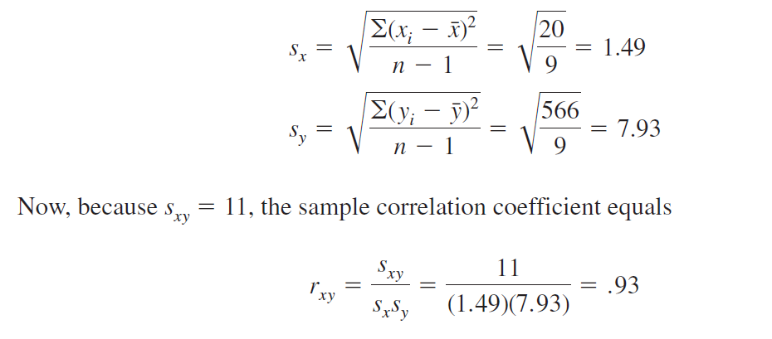

Slide 80
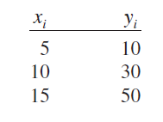
Interpretation of Correlation Coefficient
First let us consider a simple example that illustrates the concept of a
perfect positive linear relationship. The scatter diagram in Figure
depicts the relationship between x and y based on the following
sample data.

Slide 81
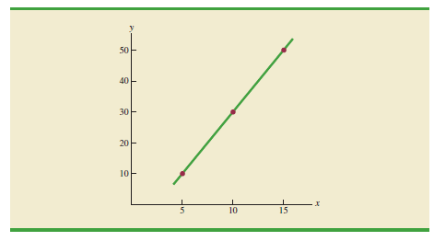
Interpretation of Correlation Coefficient
Scatter diagram depicting a perfect positive linear Relationship

Slide 82
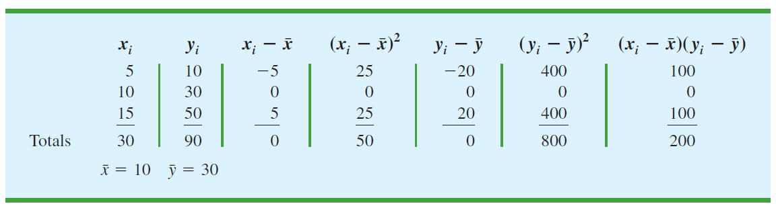
Interpretation of Correlation Coefficient
Computations used in calculating the sample Correlation coefficient

Slide 83
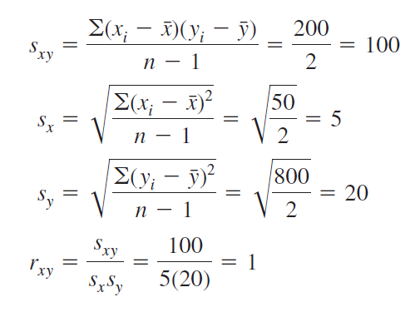
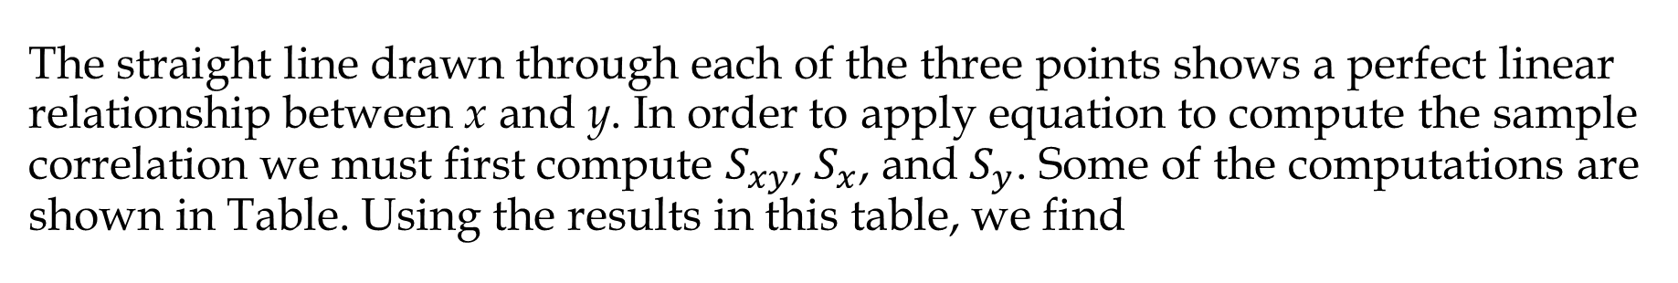
The straight line drawn through each of the three points shows a perfect linear relationship between x and y. In order to apply equation to compute the sample correlation we must first compute $S_{xy}$, $S_{x}$, and $S_{y}$. Some of the computations are shown in Table. Using the results in this table, we find
the value of the sample correlation coefficient is 1.

Slide 84
Correlation Coefficient
The coefficient can take on values between -1 and +1.
Values near -1 indicate a strong negative linear relationship.
Values near +1 indicate a strong positive linear relationship.
The closer the correlation is to zero, the weaker the relationship.

Slide 85
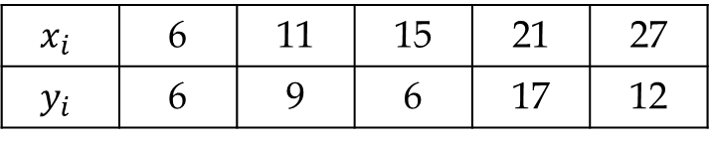
Example
Five observations taken for two variables follow.
$$x_{i}$$ | 4 | 6 | 11 | 3 | 16
$$y_{i}$$ | 50 | 50 | 40 | 60 | 30
Compute and interpret the sample covariance.
Compute and interpret the sample correlation coefficient.
Five observations taken for two variables follow.
$$x_{i}$$ | 6 | 11 | 15 | 21 | 27
$$y_{i}$$ | 6 | 9 | 6 | 17 | 12
Compute and interpret the sample covariance.
Compute and interpret the sample correlation coefficient.

Slide 86
Example
Nielsen Media Research provides two measures of the television viewing
audience: a television program rating, which is the percentage of households
with televisions watching a program, and a television program share, which
is the percentage of households watching a program among those with
televisions in use. The following data show the Nielsen television ratings and
share data for the Major League Baseball World Series over a nine-year
period (Associated Press, October 27, 2003).
Ratings | 19 | 17 | 17 | 14 | 16 | 12 | 15 | 12 | 13
Share | 32 | 28 | 29 | 24 | 26 | 20 | 24 | 20 | 22
Develop a scatter diagram with rating on the horizontal axis.
What is the relationship between rating and share? Explain.
Compute and interpret the sample covariance.
Compute the sample correlation coefficient. What does this value tell us about the relationship between rating and share?

